Slide 1
Tools for Machine Language and Artificial Intelligence

Slide 2
Data Science Workflow
Workflow
  Hypothesis : Evaluate problem, determine model and expected outcomes
    planning phase
    Use Tensorflow Keras and the Machine Learning portions
    Look at how much data we have
    Are there any sources we can extract from
  Processing : Data wrangling, manipulation, dimension reduction
    90% of Data Science Job
    Pandas, Scikit Learn, SciPy
    filter image data / selecting only specific columns
    scaling : Transforming your data into a similar scale and range of values
    Principal Component Analysis: Reducing Feature space by a desired amount based on how much they co-vary between each other
      Example can get rid of a feature : People answer question 2 the same as question 10
  Parameters : Learning rate, cost function, etc
    K fold cross validation
    accuracy metrics

Slide 3
Data Science Workflow
Training : Data Splitting Method
Testing : Model learning accuracy/assessment

Slide 4

Useful Features with Jupyter and Ananconda
Hotkeys
  press exit and you get in admin mode
  a – Create a new cell block
  dd – delete the cell block
  know your are in master mode when the left side bar is blue.
latex
  %%latex – Tell a cell that it is latex
    markdown can handle latex code withyout %%latex
    Why is it there.
  %%<Tab> See all the commands
  %timeit
SageMaker does Machine Learning Production – Does not always run on AWS
Anaconda and why it is useful

Slide 5
Pandas – Loading and Describing Data
pandas – A dataset package that has built-in functions for handling list of informatino typically shaped in rows and columns
Dataframe – The pandas object which contains functions and attributes to process large dataset quickly in Python
Read data into a data frame
  pd.read_csv(<path to file>, delimiter=’\t’, header=None)
  https://raw.githubusercontent.com/mwaskom/seaborn-data/master/iris.csv ( from sklearn import datasets )
Descriptive Statistic – Describe this information
Functions used on the Data Frame
  dataframe.describe()
  dataframe.groupby(“species”).describe()
  iris.mean() // Mean for the four columns
  iris[‘sepal length’].mean() // Mean of a column
  iris.petal_length // Display the values of the column

Slide 6
Pandas --Slicing
Code Terminology
  [] Indexing notation for data frames
  : Argument that selects subset of data from row or column
  df.iloc[,] Selects data from numerical rows and columns
Example
  iris[1:3]
  iris[1:3][‘sepal length’]
  iris.iloc[1:4,1:2]
  Example of Multiple Columns – iris[[‘petal_length’, ‘petal_width’]] // Displays multiple columns
  iris[iris.portal_length > 5 & iris.sepal_width > 2 ]
  iris.loc[iris[‘petal_legnth’].isin([4.3,5.2])]
  iris.loc[~iris[‘petal_length’].isin([4.3,5.2])] // Not in the set ( note the tilde
loc – label based data selecting method which means that we have to pass the name of the row or column which we want to select
is an indexed-based selecting method which means that we have to pass an integer index in the method to select a specific row/column.

Slide 7
Exploring Real Data
http://archive.ics.uci.edu/ml/datasets/Occupancy+Detection+
  Associated Tasks : Classification – Probably has a category with the target
read_csv can use ~ for home directory
occu.groupby(“Occupancy”).describe() // Will show you the differences between two answers
occu[“Light][:10].plot(kind=’line’).plot(kind=’line’)
occu[“Light][:max(occu[“Light”])].plot(kind=’line’).plot(kind=’line’) // Note the use of max
occ.set_index(“date”}[“LIght”][:100].plot(kind=’line’)
  // Sets the Data Frame Index

Slide 8
Other Important Logic
Code Terminology
  .iterrows() – Shows top rows of a dataframe
  .iloc – Provides statistics for each data column
  .replace() – Quick plotting back-ended on matplotlib
iris.iterrows()
  first value is the row index
  second value is a list
  iterates over the list
Example
  for row,value in irsi.iterrows():
    if sum(value[:]) > 5:
      iris.iloc(row,4) = “new”
  iris.replace(“New”, “lilly”)
Usually segment our data into X and y
iris.dtypes

Slide 9
Other Important Logic
Category Type
  iris[“species”] = iris[“species].astype(‘category’)
  iris[“species].cat .codes // A number

Slide 10
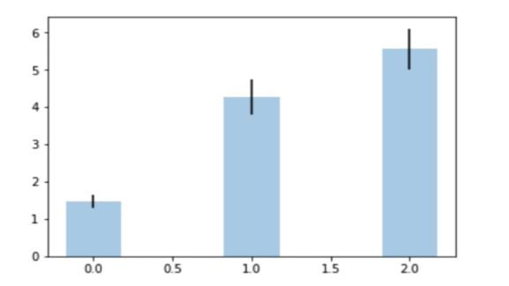
Introduction to Matplotlib
Definitions
  axes Typically denoted as x,y coordinates
  Categorical Data: Data that is typically a string ( converted to an integer ) that represents
  a particular label
  Continuous Data
  Mean Average of column
  Standard Deviation The mount of variance in your column
Rules
  Axes should always be labeled
  Bar Graph seen on the right
    BarGraphs represent the categorical data on the x axis and continuous data on the (Y)
    The line in the middle of bars is standard deviation
import matplotlib.pyplot as plot
plt.plot(x,y,’or’)
  The r is the red parameter and the o is some kind of plot
  Third parameter is Made up of Markers / Colors / Line Type know as the format string

Slide 11
Introduction to Matplotlib
  can scale the x,y
  set the opacity of x,y for scatter plots

Slide 12
Bar and Line Plots
Can’t create a bar with continuous values as the independent value
For species ( column ) generate the mean and the std (iStd)
Different type of Bar Plots
  Stacked
  Grouped
Bar Plot
  width = 35 ; plt.bar(iMeans, wdith)
  iris[“species”] = iris[“species”].astype(‘category’)
  ind = np.uniqu8e(iris[“species”].cat.codes // The location of x in groups
  plt.bar(ind -wdith /2 , iMeans, yerr=iStd, color=’SkyBlue’, label=’Species’)
Line Plot
  plt.plot
plt.subplot(x,y,z) will plot the graphs
plt.show() – will show the graph

Slide 13
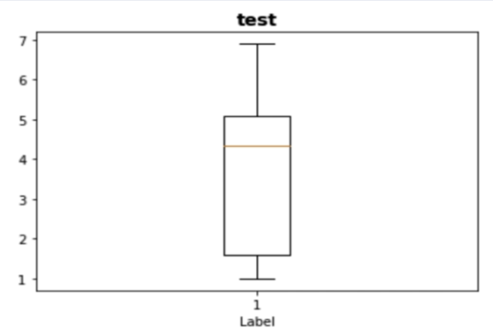
Box Plots and Subplotting
Definition
  Quartiles ranges : percentage of values that fall above a certain point ( 25%, 50%, 75% )
  Whiskers:visual representation of the boxplot quartile ranges
  Outliers : data points that are at 2.5 higher or lower than other quartile ranges ( 25, 75 )
  Medians : The exact middle of the dataset
    useful metric to use instead of mean when you have a high skew
Example
  Yellow line represents the median
  The horizontal line that make up the box are the 25th and 50th percentile
    50% of your data have values just a little bit below 2 and 5
  horizontal lines below and above show the first and last quartile

Slide 14
Box Plots and Subplotting
Example
  iris[“speicies”] = iris[“species”].astype(‘category’)
  iris[‘species’] =iris[“speicies].cat.codes
  fig = plt.figure() // Set the parameters for all the subplots
  ax = fig.add.subplot(1,1,1) // Add the subplot individual
  ax.boxplot(iris[“petal_length”]
  ax.set_title(“IRIS_DATASET”, fontsize=25. fontweight=”bold’)
  ax.set_xlabel(“Label”)
  plt.show()

Slide 15
Plotting with Real Data
Example – 2 plts on the same graph
  df = pd.read_csv(‘~/Downloads/BreadBasket_DMS.csv’)
  df = df.gorupby([‘Date’]).agg([‘count’])
  x = range(len(df.index))
  yValues = []
  [yValsw.append(row[0]) for ind, row in df[“Transaction”].iterrows()]
  fit = np.ployfit(x,yVals,2)
  fit_fn = np.polyld(fit)
  plt.subplots()
  plt.plot(x,yVals, ‘-k’, x ,fit_fn(x), ‘--r’)
  plot.locator_params(axis=’x’, nbins=20) // For each tick what is the increment ex. 1st ticks are 0,20,40,60,80
  plt.ylabel(‘Total Purchase’)
  plt.xlable(‘Day’)
  plt.grid()
  plt.show())

Slide 16
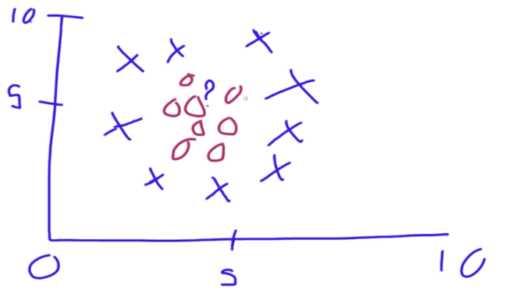
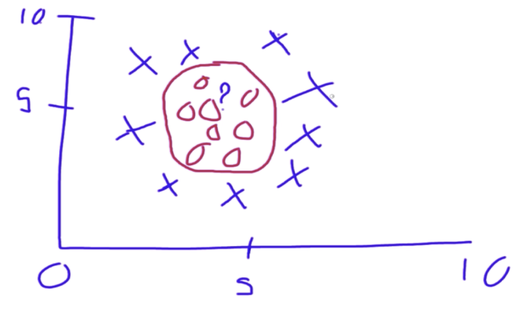
SKLearn – Introduction to Machine Learning
Types of Machine Learning
  Supervised Learning
    Classification and regression problems
    Data has labels / outcomes you can use to help correct your algorithm
    Common Types : Support Vector machines, Random Forest and Naive Bayes
    High Level of a Support Vector Machine Example
      There are two choices X, O – What is the Question Mark :?
      Linear Regression – Don’t Use
        No matter where you draw the line the answer will be as goo as chance
      We can see with our eyes the boundary
      The support vector machine is transposing the graph into 3 dimensions
      Support Vector Machine Perspective
        In 3 dimensions it is easier to draw a plane ( a 3 line )
  Kernel Transformation – Transform the data and move it into higher dimensions.

Slide 17
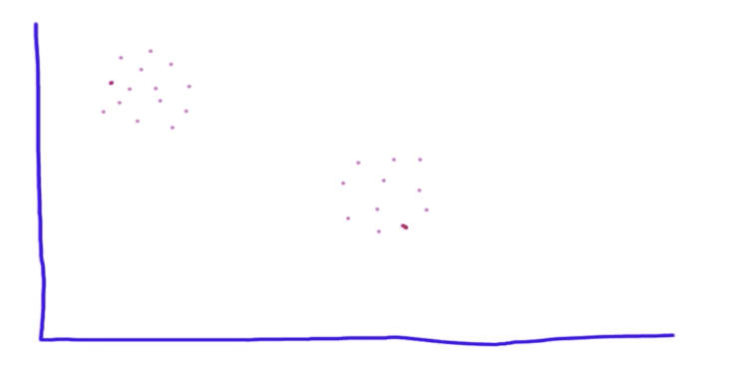
SKLearn – Introduction to Machine Learning
Unsupervised Learning
  We don’t have labels for the data
Example of K Means Clustering
  Since we don’t know anything about the data they are always dots.
  We see that there are clusters of data
  There could be hundreds of features
  K Means Clustering
    Looking for the average mean groupings for your data.
    K represents how many groups it will try to make
    Drop K centriod at random on your data
      A center point and counts the amount of data that is within its boundary
      create a number of concentric circles
      will count and compute the distances and do comparisons
      create a distribution boundary
        More accurate moving centroid

Slide 18
Reinforcement Learning
Can do supervised task without labels
Unsupervised model focused on solving performance problems
Common Types : Monte Carlo, evolutionary algorithms
Attribute a score to a certain behavior
Example person running a maze
  We have a counter : Distance to goal
  Each Step will reduce the counter by 1
  Choose a random direction and the counter goes up or down based on the score

Slide 19
Machine Learning Workflow
Example
  // Create the data and the target data frames
  x = iris.drop(“sepcies”, axis = 1)
  y = iris(“species”)
sklearn.preprocessing.StandardScalar
Convert all values to z scores – Z scores –
  z score = ( the value - the mean ) ./ standard deviation
  High value get a high zscore
  Scaling all our information by a number that is representing how much of an outlier it is ( varying from the mean )
  x = StandardScalar().fit_transform(x)
  Definition
    Describes it raw score in terms of distance from the mean
    Also known as aa standard score because it allows comparison of scores on different kinds of variables by standardizing the distribution
      position of raw score in terms of it distance from the mean
      positive - the value lies above the mean
      negative the value lies below the mean
    allow the calculation of the probability of a score occurring in the normal distribution
    allow the comparison of two scores that are from different samples

Slide 20
Machine Learning Workflow
Principal Component Analysis
  Principal component analysis simplifies the complexity in high dimensional data while retaining the trends and pattern
    Transforms the data into fewer dimensions which act as summaries of features
  orders determines the importance of the principal component 1
  At this point we are not looking at the length and widths of anything, but the principal components
  Principal Component Analysis
    pca = PCA(n_components=2) // convert it from 4 columns to 2 columns
      random = 0 get the same data every time
      whiten – Reducing variance use when you are having accuracy issues or high variation with your data
    pCs = pca(n_components=2) .fit.transform(x) Get a combination of each of the 4 features and the z scores that represent it.

Slide 21
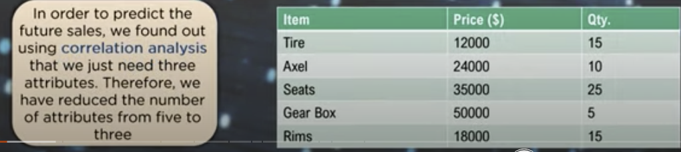
Machine Learning Workflow
https://www.youtube.com/watch?v=2NEu9dbM4A8&t=8s
Dimensional Reduction
  Use Correlation Analysis
  Why
    Less dimensions for a given dataset means less computation
    or training time
    Redundancy is removed
      In a neural network might give a higher weight when
      there is two or more
    Space Required to store the data
    Make the data easier for plotting in 2D and 3D parts
    Helps to find out the most significant features and skip the
    rest
    lead to better interpretations
Principal Component analysis is a technique for reducing the dimensionality
of datasets, increasing interpretability, but minimizing information loss
Idea : For the Iris Dataset we could do the ratio of length to width ratio

Slide 22
Machine Learning Workflow
Business models have 26 to 30 variables that they are looking at.
Important Terminologies
  Views The perspective through which datapoints are observed
  dimension Number of columns ins a dataset are called the dimensions of the dataset
  New Variables that are constructor as linear combinations or mixtures of the initial variables
  Projects – perpendicular distance between the principal components and data points
Important Properties
  Number of principal components is always less than or equal to the number of attributes
  Orthogonal
  Priority decrease as their numbers increase
    5 different point will have less value than 1 point that summarize it.
PCA performs the following operations in order to evaluate the principal components for a give data set
Steps
  Stana

Slide 23
Machine Learning Workflow
Steps
  Standardization Standardize the range of the attributes so that each one of them lie in similar boundaries
    This process involves the removal of the mean from the variable values and scaling the data with respect to a standard devication
  Covariance Matrix Computation
    Express the correlation between any two or more attributes in a multidimensional dataset
    Covariance matrix tells us how the two or more variables are related
      Positive One value is directly proportional to another variable
      Negative One value is indirectly proportional to another variable
  Eigen vectors and values Are the mathematical values that are extracted from the covariance table
    Responsible for the generation of new set of variables from old set of variables which further lead ot the construction of principal components.
    Eigen vector do not change directions after linear transformations
    Eigen values are the scalars or the magnitude of the Eigen vector
  Feature Vector
    A matrix that has eigenvectors of the components that we decide to keep as columns
    Here we decide whether we must keep or disregard the less significant principal components that we have generated in the above steps
  PCA Example
    Construct a matrix X with N rows or observations and K
    columns or variable

Slide 24
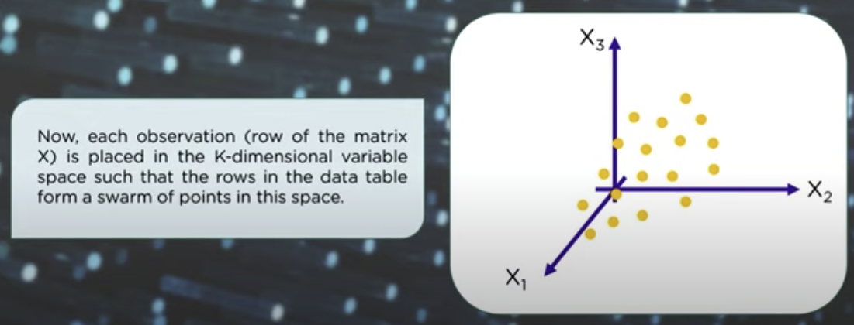
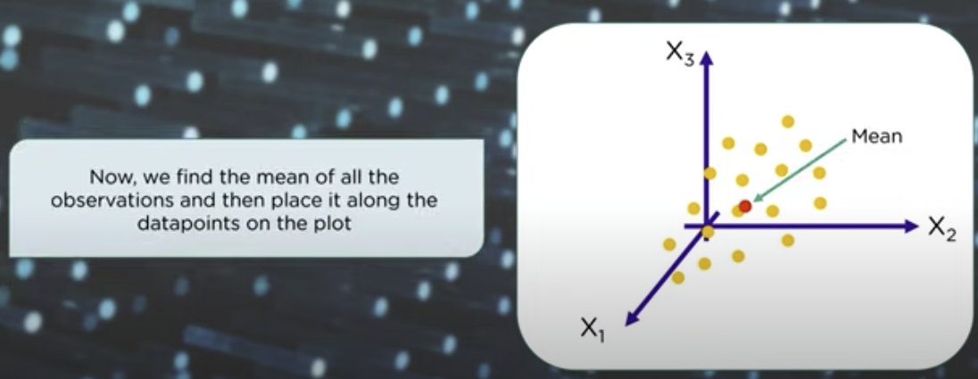
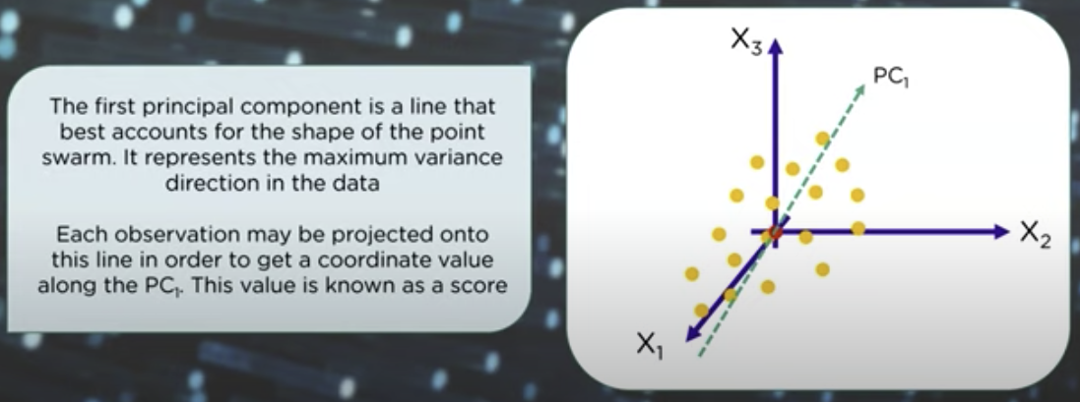
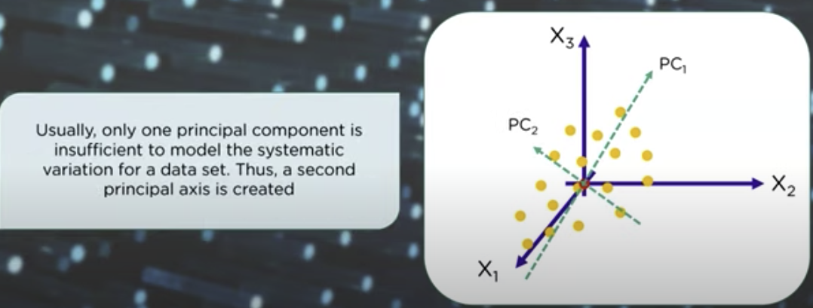
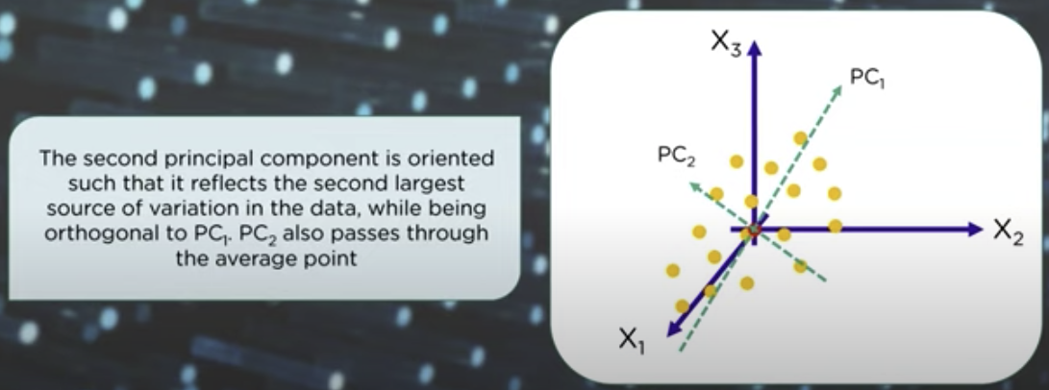
Machine Learning Workflow

Slide 25
Cross Validation and Scoring
Cross-validation is a technique in which we train our model using the subset of the data-set and then evaluate using the
complementary subset of the data-set.
Continuing the Data Science Workflow from the previous section – Machine Learning Workflow
What aspects of the ML model do we need to prime.and make sure are just right
Pass the reduction information ( principal component analysis and zscores ) to a machine learning model
  Need to make sure that our parameters have meaningful reasonable ranges to do some exploration
How do we split the data
  overfitting Training the machine learning learning too much or too hard
  underfitting Opposite of overfitting
  Training to prevent overfitting and underfitting
    Split dataset into train and test by a certain ration ( standard is 70/30 )
    Leave one out cross validation ( LOOCV) – Train on all but one piece of data and test on the final piece of data and repeat
      Then pick another one at random and run the training again until they all have been selected
      Normally not a good strategy because of overfitting, but there are some advtantages
        Useful for small data sets
    K-Fold cross-validation – Make a set of testing and training samples. Run process on each and evaluate performance
      Run K number of times and each piece of data will be in the tested once
      Reduce the issues of overfitting and some issues with performance

Slide 26
Cross Validation and Scoring
coding
  from sklearn.preprocessing import MinMaxScalar // Values range from 0 to 1
  from sklearn.model_selection import KFold, cross_val_score, LeaveIOneOut
  x = iris.driop(“species”,axis = 1 )
  y = iris[“species”]
  X MinMaxScaler().fit_transform(x)
  svc = SVC(kernel = “linear”, C=1, gamma = ‘auto’)
  // Example of K Fold
  k_fold = Kfold(n_split=5) // Random allows use to get the same data every time
  results = cross_val_score, x, y, cv=k_fold)
    Return a List of accuracies : [ 1, 1, .5, 93, .6 ] –

Slide 27
Cross Validation and Scoring
Example of leave one out
  loo = LeaveOneOut()
  for train_index, test_index in loo.split(x):
  x_train, x_test = x[train_index]
  y_train, y_test=y[train_index]
  svc.fit(x_train, y_train)
  y_pred = svc.predict(x_test)
  acc = metrics.accuracy_score(y_test, y_pred)
  print(acc)
  Result – Return a list with values 0 or 1 ( wrong or right )
This section : Should be doing it with all model since it helps prevent overfitting / underfitting

Slide 28
SVM and Visualizing Boundaries
SVM -
  Supervised Machine learning Algorithm used for classification and regression
  Create the best line or decision boundary that can separate n-dimensional space
  Find a line/plane/hyperplane that creates a boundary between two type of data
  Basic form can only perform binary classification can be extended to multiple variables
  Works very well with linear separable data
    If the data is not linear separable then map the data to a
Parameters
  Gama – Learning Rate
    Too High Miss nuisance in learning
    Too low Might not be finding enough significance difference between data points
  Kernel – What kind of line is it trying to create or plane ( A 3D line)
    Use the plane to find a better and can convert it using tricky math
    different types of kernel draw different lines ( polynomial , gaussian, linear, sigmoid, rbl )
    Used to create regions in different ways.
  C: Error term – Penalty parameter for C of the error term

Slide 29
SVM and Visualizing Boundaries
## 4.4 Visualizing boundaries of a supervised ML
import numpy as np from sklearn import svm, datasets from sklearn.model_selection import train_test_split import matplotlib.pyplot as plt
iris = datasets.load_iris()
x = pd.DataFrame(iris.data[:,:2], columns=iris.feature_names[:2]) // Pulling in raw numbers for sepal length and width
y = pd.DataFrame(iris.target, columns = ["species"], dtype='category') // Create Target – don’t forget category is a datatype
svc = svm.SVC(kernel='rbf', C=10, gamma=1) // RBF- radial basis function ( gaussian blob)
x_train, x_test, y_train, y_test = train_test_split(x, y, test_size=0.3,random_state=0)
svc.fit(x_train,y_train) // Call fit data
# # create a mesh to plot in
x_min, x_max = x.iloc[:,0].min() - 1, x.iloc[:,0].max() + 1 // Get the min/max values for the x and y axis
y_min, y_max = x.iloc[:,1].min() - 1, x.iloc[:,1].max() + 1 // Create the small squares fill int color
h = (x_max / x_min)/100
xx, yy = np.meshgrid(np.arange(x_min, x_max, h), np.arange(y_min, y_max, h)) // Create a range of values between the min and max x/y values
Z = svc.predict(np.c_[xx.ravel(), yy.ravel()])
Z = Z.reshape(xx.shape)
fig = plt.figure(figsize = (8,8))
ax = fig.add_subplot(1,1,1)
ax.pcolormesh(xx, yy, Z, alpha=0.8) // Visualize the boundaries – Create a scatterpiont and where the point is if it landed inside the model
ax.scatter(x.iloc[:,0], x.iloc[:,1], c=y['species'].cat.codes, cmap=plt.cm.Paired)
ax.set_xlabel(iris.feature_names[0])
ax.set_ylabel(iris.feature_names[1])
plt.show()

Slide 30
Random Forest and Decision Trees
Random Forest is commonly used machine learning algorithm which combines the multiple decision trees to reach a single result
Random Forest are really great since they are robust and flexible
  Handle all different types of data such as continuous or categorical // regression or classification // can be unsupervised in some ways
Definitions
  Decision Node: When a node splits into further sub-nodes
  Terminal Node: Node that does not split
  Splitting: process of dividing decision node
  Pruning: removing sub-nodes from a decision node – Done when all the samples have already been accoutered for elsewhere in the tree
Decision and Random forest – Subset Data across different categories.
  How much you subset across a column or category is used as an analysis point for how different categories are being made
Decision Tree
  Select a variable to split data across ( create child nodes )
  Parameter – Calculate Gini index for the select variable ( parent node ) – Parameter
    The Gini Index is how much disparity there is between two samples – How much data is sample between one group and another.
    The higher Gini more income inequality for that area
      0.0 represents perfect equality and 1.0 representing perfect inequality
    Measures resource distribution among population.
    Other types are Entropy
  Select new variable in child node to split repeat the process

Slide 31
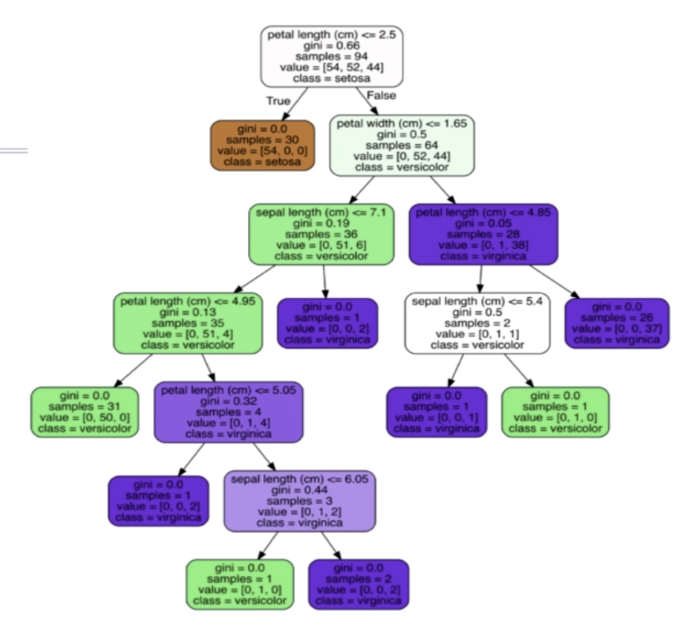
Random Forest and Decision Trees

Slide 32
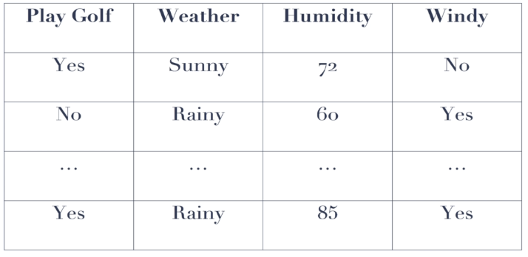
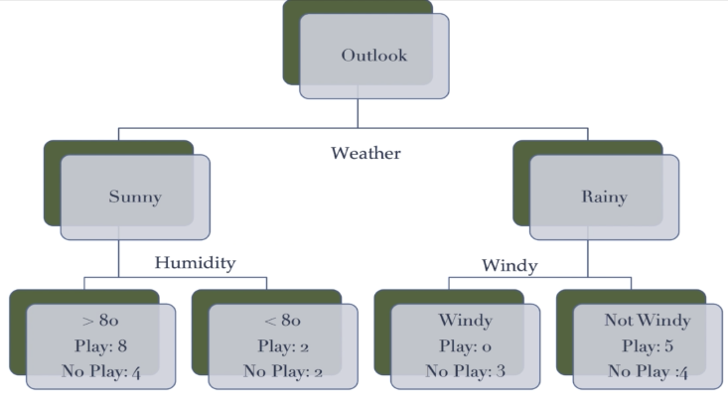
Random Forest and Decision Trees
Example – Playing Golf based on weather ( see the two pictures to the right )
  All the splits allow use to determine what features were important
  Also what features were important for other features
  Summarize all decision splits determine the importance fo the features
  Think this one is classification
Example

Slide 33
Random Forest and Decision Trees
from sklearn.datasets import load_iris from sklearn.ensemble import RandomForestClassifier from subprocess import call= from sklearn.tree import export_graphviz
# Load data and process
iris = load_iris()
x = pd.DataFrame(iris.data, columns=iris.feature_names)
y = pd.DataFrame(iris.target, columns = ["species"])
rF = RandomForestClassifier(n_estimators=5) // How many decision tree that we want it to make. Other parameters ( max depth )
# Scale and Reduce
# ...
# Train
rF.fit(x,y)
# Cross-validate
# ...
estimators = rF.estimators_[2] # Select a tree from the forest
# Visualize the decision tree
# Represent visualization as dot file
export_graphviz(estimators, out_file='tree.dot', – Look into using this as a good validation
feature_names = list(x),
class_names = iris.target_names,
rounded = True, precision = 2,
filled = True)
### Convert to png using system command (requires Graphviz)
call(['dot', '-Tpng', 'tree.dot', '-o', 'tree.png'])

Slide 34
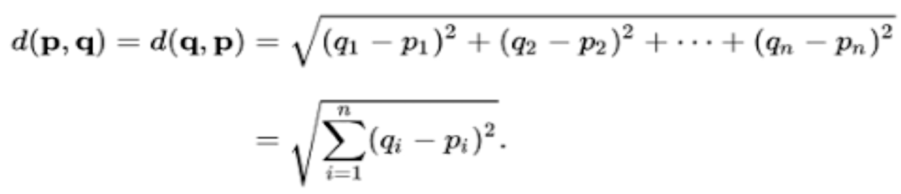
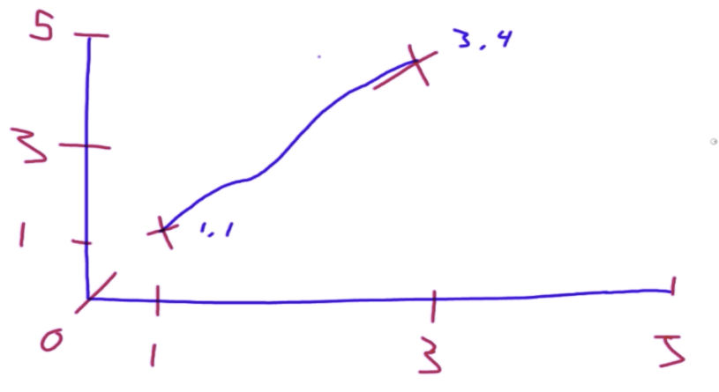
KNN and K-Means Clustering
Cost function
  Euclidean Distance
    staring line distance point between x1 and x2
  Euclidean and Manhattan are
    approximates
    ML Algorithms use these to determine how near they are to each other.
  For these type of algorithms you have a parameter called P
    P is your distance metric function and operates under 1 of 3 types
      Euclidean distance
      Manhattan distance
        Comes from the question. How do we calculate the distance
        a task cab has to drive through Manhattan
        Not a grid, but they did a bunch of left and rights
          Step Size – How Far up or down / left or right
          can be large or small
            The larger the less exact
      Minkowski Distance

Slide 35
K-NN and K-Means Clustering
KNN – Supervised ( https://www.youtube.com/watch?v=UR2ag4lbBtc for extra information )
  Assume the similarity between the new case/data and available cases into the category that is most similar to the available categories
    Non Parametric algorithm does not make any assumption on the underlying data
    lazy learning algorithm – It does not make any assumption on underlying data.
      At the time of classification it performs an action on the dataset
  Need to know how many clusters
  Select the number of K for the K-NN Algorithm
  Randomly drops a new point and creates these concentric circles and finds the amount of neighbors
    needed to do it distance calculations whether or not they are the same label.
    Do calculations to other points that were not in its boundary
    Ask the question who were your k closest neighbors
      Count the number in each category and the one with the maximum
  Pick odd numbers so there is never a tie ( especially with 2 features )
  The distance calculation is our cost function
  Keeps dropping points and create concentric circles to optimally segment using two points need to be.
  Look for two data points that are specific label or category

Slide 36
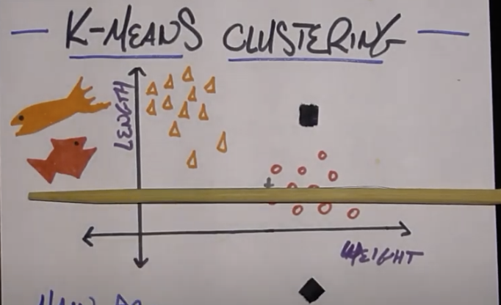
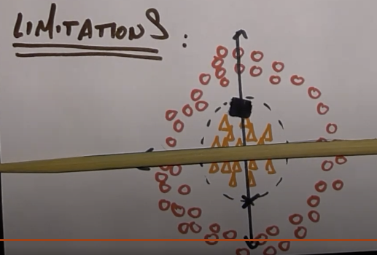
K-NN and K-Means Clustering
K - Means Clustering – Unsupervised
  Don’t know anything about the data, but need to know how many groups the data is divided into
  // Drop Two Centroids and calculate distances and see how far one group of data is from another
    // The Shortest point should be the optimized cluster
  Algorithm
    Choose 1 random point for each group The one top Salmon and the one on the bottom is tuna
      These are mean ( averages )
    Then create a line that separates the data.
      May cause some groups to be split.
        Example the red circle
      Based on all the point on above and based on all the points below the line
        it takes all the averages of all the dots in its space
        The algorithm reinitializes by making the line equidistant between
        the two averages ( mean )
        Determine to stop when there is no change in the assignments.
  K-Means will drop two randoms and find another point and do the calculations
  Calculations are cheap
  Limitations – Two clusters that are concentric circles and set the mean above and below –
  Will not move much symmatry
  When one cluster is much larger then the other cluster

Slide 37
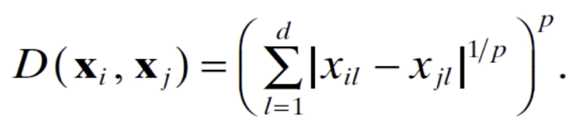
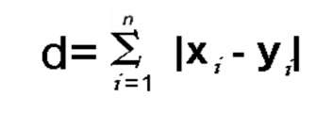
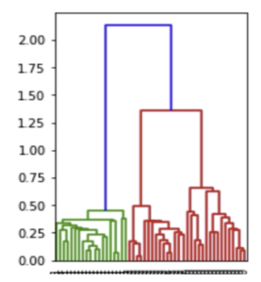
KNN and K-Means Clustering
Minkowski Distance
  A generalization of both Euclidean and Manhattan
  Depending on what you set “p” to
    Set to P to 1
      Get the Manhattan Distance
    Set to P to 2
      Get Euclidean distance
Definitions
  Dendrogram – A Tree like diagram that splits categories into sub nodes
  K-MEANS can be built in hierarchical way
    Better decision criteria then selecting centroids and building boundaries

Slide 38
KNN and K-Means Clustering
from sklearn.cluster import KMeans
from sklearn.neighbors import KNeighborsClassifier
from sklearn.preprocessing import StandardScaler
from sklearn import datasets
import matplotlib.pyplot as plt
iris = datasets.load_iris()
x = pd.DataFrame(iris.data[:,:2], columns=iris.feature_names[:2])
y = pd.DataFrame(iris.target, columns = ["species"],dtype='category')
kmeans = KMeans(n_clusters=3, n_init = 10)
kmeans.fit(x)
kmeans_predict = kmeans.predict(x)
# Will be able to get labels (cluster) , but the labels will not be related to our Y dataset. Don’t know if the clusters are what you expect them to be.. Can’t do a scoring method since
we don’t have a scoring methods – Difference between KNN and K-Means is knowing the labels
### KNN Example
x_train, x_test, y_train, y_test = train_test_split(x, y, test_size=0.3,random_state=0)
knn = KNeighborsClassifier(n_neighbors=3, algorithm='auto', p=1)
knn.fit(x_train,y_train)
knn_predict = knn.predict(x_test)
knn.score(x_test,y_test)

Slide 39
KNN and K-Means Clustering
# # Visualize
h = .02
x_min, x_max = x.iloc[:,0].min() - 1, x.iloc[:,0].max() + 1
y_min, y_max = x.iloc[:,1].min() - 1, x.iloc[:,1].max() + 1
xx, yy = np.meshgrid(np.arange(x_min, x_max, h), np.arange(y_min, y_max, h))
Z = knn.predict(np.c_[xx.ravel(), yy.ravel()])
Z = Z.reshape(xx.shape)
fig = plt.figure(figsize = (8,8))
ax = fig.add_subplot(1,1,1)
ax.pcolormesh(xx, yy, Z, alpha=0.8)
ax.scatter(x.iloc[:,0], x.iloc[:,1], c=y['species'].cat.codes, cmap=plt.cm.Paired)
ax.set_xlabel('Sepal length')
ax.set_ylabel('Sepal width')

Slide 40
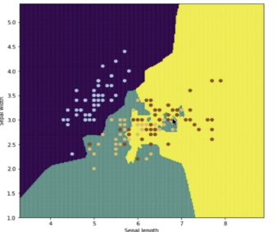
KNN and K-Means Clustering
Example of overfitting or overfitting
  The green islands in the yellow
  Also demonstrates how important parameter are

Slide 41
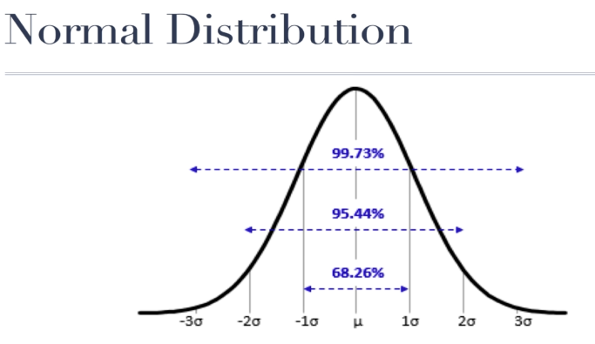
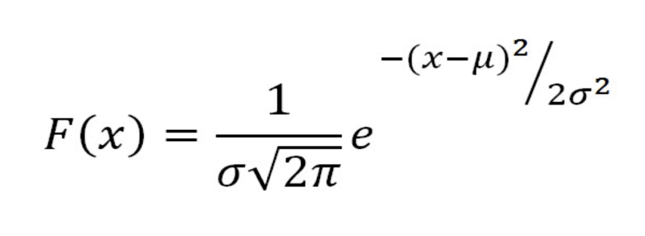
GMM and Visualizing Clusters
Normal Distributions is the bell curve.
  One Dimensional
  μ – Expect most data to fall within
  σ – Standard Deviation
How likely this data set is represented by a mean of this value and a
standard deviation of this value
  assuming it normal distributed
Called the Gaussian mixed model
Get a couple of centroids and we want to build Gaussian distribution blobs
around that ot find what the most like centroids given a specific mean and variance
Parameters
  convariance_type : String describing the type of covariance parameter
  to use. Used for calculating distances and how much they vary between
  each other.
  init_params accepts kmeans ( initialized using kmeans) or random
    not the algorithm, but the process to build out its learning
  warm_start – Set warm_start equal to true then the solution s of the last fitting is used as the initialization for the fit .

Slide 42
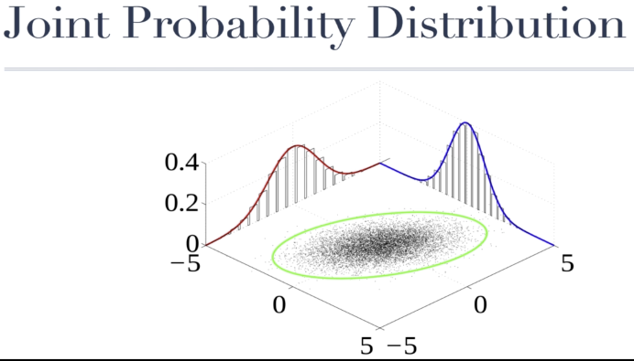
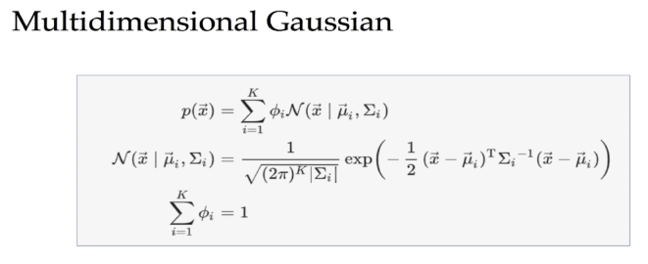
GMM and Visualizing Clusters
The Blue and Red curve are features
  You can combine these two distributions together to get a representation of
  that data in two dimensions
  The Green will be found using the Gaussian Mixture Model comparing the red
  and blue distribution
    Set a bunch of of circle and centroid in order to best encapsulate this
    data from other cluster
    Algorithm
      select a point at random
      generate the boundary which is going to be a difference shape and sized circle
      determine how much data it can account for that boundary
Create the boundary that borders or that finds the centroid which is going to have the
highest expectation for a cluster of data that encapsulate most of the data possible give the
potential option s

Slide 43
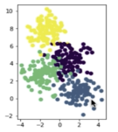
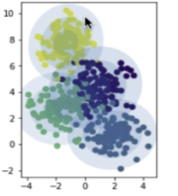
GMM and Visualizing Clusters
import matplotlib.pyplot as plt from matplotlib.patches import Ellipse import numpy as np from sklearn.datasets.samples_generator import make_blobs import sklearn.mixture as gmm
X, y_true = make_blobs(n_samples=400, centers=4, cluster_std=1, random_state=0) // Create the Data
model = gmm.GaussianMixture(n_components=4, warm_start=False, init_params = 'kmeans')
model.fit(X)
y_predict = model.score(X)
plt.subplot(1,2,1)
plt.scatter(X[:,0], X[:,1], c = y_true, s=40, cmap='viridis')
plt.axis('equal')
plt.subplot(1, 2, 2)
ax = plt.gca() // Get the current acis
ax.scatter(X[:,0], X[:,1], c = y_true, s=40, cmap='viridis')
ax.axis('equal')
w_factor = 0.2 / model.weights_.max()
for pos, covar, weights in zip(model.means_, model.covariances_, model.weights_): // Get the means and covariances and weights
U, s, vt = np.linalg.svd(covar) // Dimension reduction
angle = np.degrees(np.arctan2(U[1, 0], U[0, 0]))
width, height = 2 * np.sqrt(s)
# Draw the Ellipse
for center in range(1, 4):
ax.add_patch(Ellipse(pos, center * width, center * height, angle, alpha = weights * w_factor))
plt.show()
know n_components ahead of time it is the parameter centers in the make_blobs
Show the boundaries. Each concentric circle is another standard deviation

Slide 44
Answer
KNeighborsRegressesor vs KNearestNeighbor
  labels vs continuous variable
StandardScalar
  can’t scale categories
Principal Component Analysis
  Example – Survey data which questions cluster together and are similar in terms of the way they are answered across different people
    Are the depression answers similar
The score in Scipy is between 0.0 and 1.0 where 1,0 is overfitting
  In the early folds it is overfitting

Slide 45
SCIPy
Definitions
  Scipy: Statistics and common / useful science-orientated algorithms
  T-test determines whether there is a significant difference in means between two groups only one continuous variable
    independent – They are from different sources
  Chi-square – determines whether there is a significant way from the theoretical expectation ( commonly used in low N survey analysis )
    Are there difference between different group of questions or different group of answers
  Linear regression : A correlation analysis between two continuous variables. Output includes correlation, slope of the line and r^2
    optimize the function so that the regression is in the middle
  Test of normality ( Shapiro) – where your data is distributed in a normal way. If so can use parametric methods
  , Homogeneity of variance (Bartlett) – Is the variance of the data is different
Syntax
  from scipy import stats
  stats.ttest_ind(x[“sepal length (cm”], x[“petal_length (cm”)
    get a tuple of T value and P value – numpy T Test does not provide P value
  stats.shapiro(x[“sepal length (cm”], x[“petal_length (cm” )
    get a Shapiro ( closer to 1 more likely it distributed ), Pvalue – The likehood based on the data that it was generated by random chance

Slide 46
SCIPy
stats.bartlett(x[“sepal length (cm”], x[“petal_length (cm”])
  Get a Bartlett Result and a Pvalue
  Pvalue 1.0 then the data is the same and 0.0 then they are different
calculate z-scores
  0 perfect score for data set
  3 mean
states.linrgress
stats.chisquare

